Slide 1
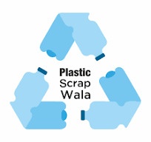
Price Methodology
Plastic-Scrap Wala Mobile App
Owned and Operated by Kalpataru Polymer Pvt. Ltd.

Slide 2
About Us
Plastic-Scrapwala is India’s leading digital platform dedicated to the plastic recycling industry.
We provide real-time price updates, market trends, and industry news through our intuitive mobile app—empowering recyclers, traders, manufacturers, and stakeholders with the information they need to make smarter decisions, faster.
Founded (in 2017) with the mission to bring transparency, accessibility, and efficiency to the fragmented plastic scrap market, Plastic-Scrapwala bridges the information gap that has long challenged the sector.
Our platform offers daily updates on rates for various types of plastic scrap, insights into domestic and international markets, government policy updates, and expert analysis—all in one place.
Whether you're a small scrap dealer or a large-scale recycler, Plastic-Scrapwala helps you stay ahead of the curve.
With a rapidly growing user base across India, we’re proud to be shaping a more informed, connected, and sustainable future for the plastic recycling ecosystem.
Stay updated. Stay competitive. Recycle smarter—with Plastic-Scrapwala.

Slide 3
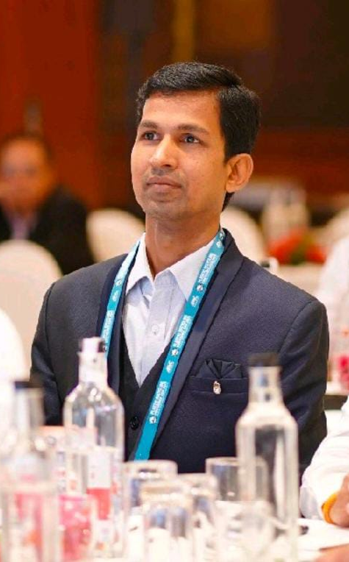
About the Founder
Shri Sandeep Kumar Soni is a seasoned professional and entrepreneur in India’s plastic recycling industry, with over a decade of hands-on experience.
He began his journey in 2014 by working at the grassroots level—recycling PET bottles and trading PET scrap bales. During this time, he gained a deep understanding of the challenges and inefficiencies that plagued the industry, particularly the lack of reliable and timely market information.
Driven by a vision to bring transparency and structure to this highly unorganized sector, he transitioned from operations to information. Recognizing the vast information asymmetry in the plastic recycling ecosystem, he bootstrapped a digital venture—Plastic-Scrapwala—India’s first and most trusted mobile app providing price updates, news, and market analysis tailored specifically for the plastic recycling industry.
Under his leadership, Plastic-Scrapwala has grown into the most popular and neutral platform in its space, relied upon daily by thousands of recyclers, traders, and manufacturers across India.
His commitment to impartiality, accuracy, and accessibility has not only earned the platform its credibility but has also helped uplift the industry by enabling informed decision-making. Today, Shri Sandeep Kumar Soni continues to lead with the same grassroots ethos—empowering others with knowledge, connecting the unconnected, and driving positive change in India's recycling landscape.

Slide 4
Four – pronged methodology for price assessment
Market assessment and Market Survey
Live! Buy Sell Offers marketplace
Modelled Fair Prices
Prices derived via Bid and Book
(for Bulk Booking)

Slide 5
Market Assessment and Market Survey
We connect with market participants to gather price information and then triangulate the data with word on the street by speaking to the peer group for the same product.
PSW staff is also experienced in benchmarking and assessing indicative price formation across the value chain of participants for a given product in a Polytype.
All assessments are undertaken by trained members of PSW's team in accordance with PSW's methodology.
PSW's team members gauge market conditions which drive prices of products under various Polytypes.
With this information, PSW's team members engage with market participants to establish the range and depth of trades.
PSW is an independent and neutral third party. We do not buy or sell any of the commodities for which we provide pricing data.
PSW team members apply a certain degree of judgement while assessing prices as the scrap collection and aggregation in India is done primarily by the unorganized sector.

Slide 6
Live! Buy Sell Offers marketplace
We have created a market place for Live! Offers from Buyers and Sellers on Plastic-Scrapwala Mobile App
These Live! Offers are for products (recycled granules and scrap) for which indicative prices are published on Plastic-Scrapwala Mobile App
Prices seen in these Live! Offers are quoted by actual buyers and sellers wanting to transact in the market. So, they help us learn deviation (if any) between these quoted prices and PSW published prices.
The number of Live! Offers for a certain commodity also helps PSW team members learn about demand / supply strength and weakness at a given point in time in that product.
Posting Live! Offers on Plastic-Scrapwala Mobile App is FREE for all -- this allows all participants in the recycling complex to post their offers making it a marketplace.
PSW team members continuously monitor for any frivolous Live! Offers and immediately either request the Buyer or Seller of the Offer to make correction in the Live! Offer.
PSW is an independent and neutral third party. We do not buy or sell any of the commodities for which we provide pricing data.

Slide 7
Modelled Fair Prices (for Scrap and Recycled Granules)
We have developed an algorithm to extrapolate prices based on global indicators, movement in crude oil prices and prices of intermediates.
These algorithms are the backbone for estimating fair prices across products across Polytypes.
For example, our algorithms work on correlations between crude oil and other intermediates harmonized with import export pricing data — ensuring minimal or no subjectivity in estimating and assessing virgin and recycled granule prices. In addition, the model also takes in to account the standard price spreads between virgin to recycled granules and further down to scrap.
Modelled Fair Prices Premium or Discount to recent actual traded prices also help gauge demand strength and supply weakness in the market for a certain product in a given polytype.
Calculations are subject to PSW's editorial team and management, taking into account the views of relevant stakeholders -- before publishing these under the corresponding section ‘Fair Prices’ on the Mobile App
PSW is an independent and neutral third party. We do not buy or sell any of the commodities for which we provide pricing data. This is crucial for ensuring that the data our clients rely on is as trustworthy as possible.

Slide 8
Prices derived via Bid and Book
Companies use this feature on Plastic-Scrapwala Mobile to App to encourage competitive bidding for their raw material procurement as well as sale of finished goods in bulk.
Pricing based on bids accepted by companies, can also be seen as actual transaction prices, is the most reliable method for price discovery because it is based on competitive bidding in actual transactions.
Because we report prices and produce benchmarks based on transaction-based data,
We comply with certain internal standards:
  PSW will not be counter-party in any transaction
  The idea is to enable trade between a company (that wants to deal in bulk) and multiple vendors / suppliers
  The Book and Bid must have a meaningful volume
  Require a minimum number of participants
We have received favorable opinions from companies and industry-experienced market participants for trade enablement via the above offering.

